Slide 1
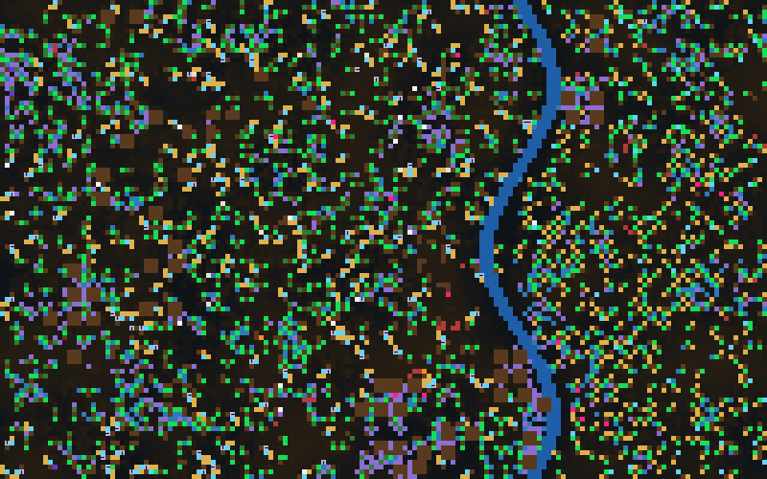
Evolutionary death in a Life Engine savanna
CSC4044Z · ARTIFICIAL LIFE · TEAM CLAMS WITH PLANS
Before and after our new features: how zebras, rhinos and leopards adapted, failed, or drove themselves extinct
Clams With Plans: Vimbai · Moreblessing · Ashley · 21 October 2026
Notes:
We are Clams With Plans. Our question: can a savanna of zebras, rhinos, leopards, grass and bushes drive itself extinct by mis-adaptation, and how is that different from simply failing to adapt? We compare two set-ups. Before: we seed our species into the original engine and let them run. After: the same species with our new cells and environment features. The background image is a real screenshot from the modified engine at tick 40,000.

Slide 2
Four ways a population can die out
KEY TERMS
Evolutionary death
Evolutionary suicide
A lineage reaches zero living individuals. This is the outcome; the three terms below are the different causes.
Mis-adaptation. The species adapts successfully, maybe becoming dominant, but the very trait behind its success removes the conditions it depends on.
Failure to adapt
Predator boom-bust
The species simply lacks the traits to cope with its environment or competitors, and collapses without first succeeding.
An ecological collapse: predators multiply on easy prey, then age out or starve. Caused by numbers, not by an evolved trait.
Notes:
We only define the terms we need to talk about evolutionary death. Evolutionary death is the outcome: the lineage hits zero. The question is always why. Evolutionary suicide is the interesting one: the trait is good for each individual, which is why it spreads, but the population as a whole destroys what it depends on. Failure to adapt is the opposite: nothing useful spreads and the species just declines. Predator boom-bust is an ecological collapse, not an evolutionary one, and we keep it separate so we do not mislabel it as suicide.

Slide 3
A decline alone is not suicide: all four must hold
EVIDENCE RULE
1
2
3
4
Success first
A trait spread
Food destroyed
Self-caused
The population grew to at least 1.5 times its starting size.
Mouths per animal rose by 0.4 or more, or the killer-cell share rose by 0.3 or more.
Food plants fell by at least 25% between the peak and extinction.
Deaths came from starvation, ageing without replacement or the lineage’s own killers, not another species.
Growth plus a spreading trait but only three criteria = suicide candidate. A collapse without growth = failure to adapt.
Notes:
This is the rule we committed to before running the experiments, and our analysis script applies it to every run so we cannot cherry-pick. A run only counts as evolutionary suicide if the population first succeeded, a trait spread, the food was destroyed, and the deaths were self-caused. If another species did most of the killing, it is a collapse under predation instead.

Slide 4
Three animals, two plants, all original cells
BEFORE · THE SEEDED SPECIES
mouth
armor
eye
mouth
eye
mover
killer
mouth
eye
producer
producer
producer
armor
mover
armor
producer
producer
producer
eye
mover
killer
mover
killer
mover
producer
producer
armor
armor
grass (3 cells)
zebra (6 cells)
leopard (6 cells)
bush (5 cells)
rhino (8 cells)
Seeded on a 160 × 100 grid: 36 zebras in 6 herds, 12 rhinos, 16 leopards, 140 grass, 45 bushes. Original rules, no water or river.
Notes:
This is the “before” setup: we took our species, built only from the original cell types, put them all into the environment, and watched what they did. Zebras are fast herd grazers with two eyes and a rear kick. Rhinos are big, armoured and slow. Leopards have jaws, meaning a killer cell on each side of the mouth. Grass and bush are both plain producer plants. The only small change from the stock engine is that plants can reproduce from the food they produce; without that, mouthless plants never reproduce at all.

Slide 5
Each copies a real trade-off, so they are clearly distinct
WHY THESE SPECIES
Species | Real-world basis | Strengths | Weaknesses
Zebra | Fast, vigilant herd grazer | Two movers, two eyes, a kick that wounds leopards | One mouth, no armour, poor at eating bush food
Rhino | Huge, armoured, slow breeder | Armour gives the most health; hard to kill | One mover; armour makes each calf expensive
Leopard | Stealthy ambush hunter | Jaws on both sides of the mouth; fast | No armour; kicked by zebras; depends on prey
Grass | Fast-spreading, shallow-rooted | Small, so it reproduces fastest; full-value food | Thirsty; easily grazed
Bush | Woody, thorny, deep-rooted | Larger food patch; later needs half the water | Its food feeds grazers poorly
Three animals with different diets and defences; two plants that differ in size, water use and food value. The body plans differ by far more than 3 cells.
Notes:
The brief asks whether our species are distinct and how we justify them. Each species copies a real animal or plant so that every modification acts on a trade-off the species already has. Zebras trade armour for speed and vigilance. Rhinos trade speed and breeding rate for toughness. Leopards are strong attackers but fragile and dependent on prey. Grass and bush differ in size, water use and food value, which is what lets bush act as a worse fallback food after our changes.

Slide 6
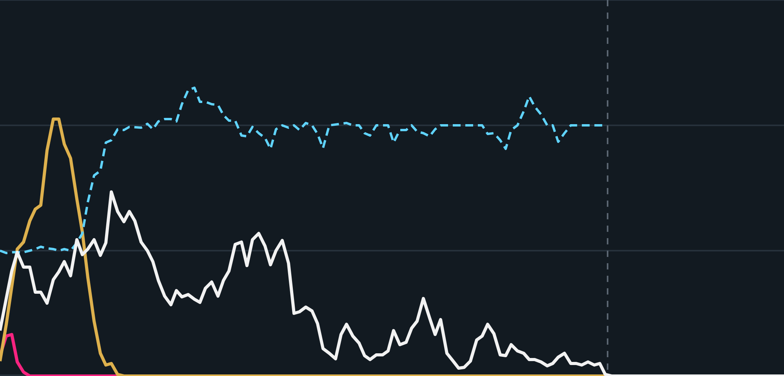
Predators and rhinos crashed; zebras mutated, then died
BEFORE · JUST LETTING THEM RUN
Zebras
Rhinos
Leopards
Mouths per zebra (right axis)
All 3 seeds
300
3
Leopards: boom to 31–33, then gone by tick 1,400–8,300 (3 of 3)
Rhinos: boom to 209–356, then extinct (3 of 3)
200
2
Zebras: survived in 1; died out in 2
Seed 3 (shown): mouths rose to 2.37, yet zebras died at 31,000 while grass was plentiful
100
1
0
0
0
10k
20k
30k
40k ticks
Notes:
This is the simplest “before” experiment: all species in, default settings, no interference. Leopards boomed on the herds and then died out, because the first boom generation aged out without enough kills. Rhinos boomed hard, up to 356, and then collapsed. Zebras survived in one seed and died out in two. In seed 3, shown here, zebras did evolve more mouths, up to 2.37 per zebra, which counts as a trait spreading. But they died out at tick 31,000 while grass was recovering to over 1,400 plants, so the trait did not destroy their food. Our classifier labels it a suicide candidate, three of four criteria, not confirmed suicide. So with default settings we saw extinction, but not clear evolutionary suicide. That sent us searching for conditions that would produce it.

Slide 7
We tried six set-ups; only one gave true suicide
BEFORE · HUNTING FOR EVOLUTIONARY SUICIDE
EXTINCTION, NOT SUICIDE
RHINO SUICIDE, 1 RUN
FAILURE TO ADAPT
1 · Default
2 · Less food
3 · No mutation
Nothing changed. Rhinos and leopards died out; zebras died in 2 of 3 runs, but their food never ran out.
Plants made less food. Zebras died out in all 3 runs; in one, rhinos evolved killers and wiped out their own food.
Less food and evolution switched off. Nothing could change, so every species died out.
ENGINE ARTEFACT
EVOLUTIONARY SUICIDE, 3 OF 3
NOT COUNTED
4 · Plants clog the map
5 · Killers hurt plants
6 · Killer given at start
Very fast plants, few grazers. Food filled every space, no one could give birth, all died by tick 3,500.
Zebras start with no killer. They evolved one, boomed to 560, destroyed every plant, then died out.
Same as 5, but we gave zebras the killer. They died fast, but the trait did not evolve.
Notes:
After the default run, we deliberately searched for conditions that cause extinction, three runs each. Read each card as: what we changed, what happened, and our verdict at the top. Less food made everything die faster, and in one run rhinos evolved killers and destroyed their food. With evolution switched off, nothing could adapt, which is our failure-to-adapt baseline. The clogging runs died for a mechanical reason, so we do not count them. Card 5 is the key result: zebras that started without a killer evolved one, and that trait wiped out their food. Card 6 is our control: giving them the killer at the start also killed them, but that is not evolution, so it does not count as suicide.

Slide 8
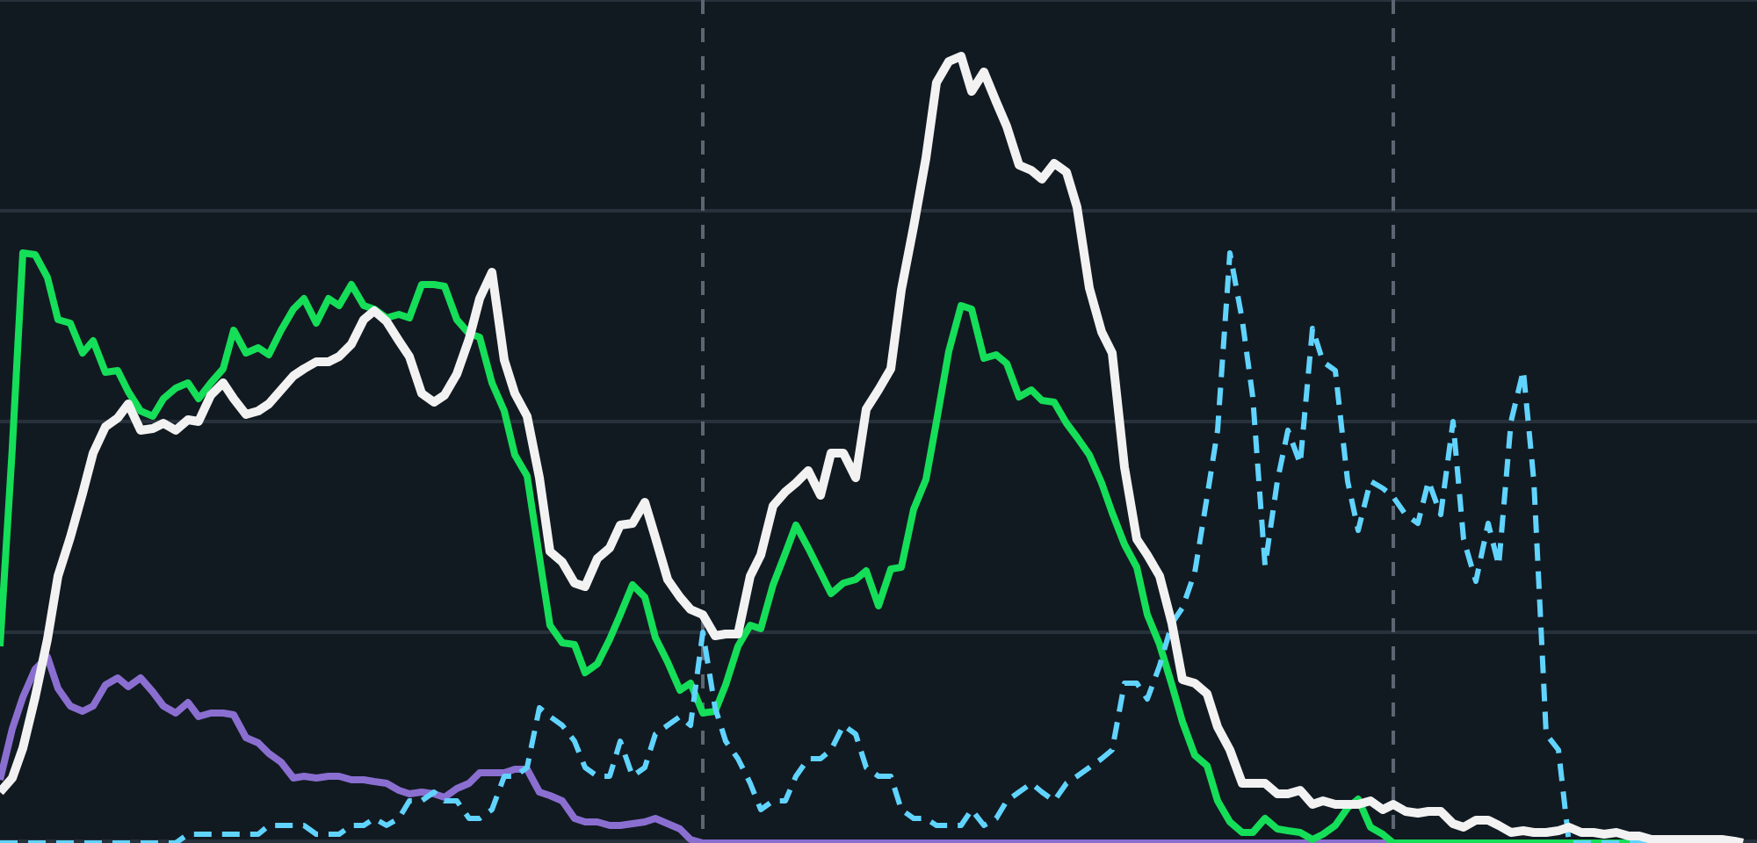
Zebras evolved a plant-killer and ate themselves out
BEFORE · EVOLUTIONARY SUICIDE FOUND
Zebras
Grass plants
Bush plants
Zebras with a killer cell (right axis)
36 → 560
600
100%
zebras at the peak, tick 8,200
450
75%
0 → 70%
of zebras carried an evolved killer cell
300
50%
0 plants
bushes gone at 6,000, grass at 11,900 (dashed lines)
150
25%
Extinct
0
0%
last zebra died at tick 14,881
0
5,000
10,000
15,000 ticks
Notes:
This is the engine’s population chart, redrawn from the EcoStats log for this run so all four lines fit on one slide. The zebras started with no killer cell. One evolved, and in the old engine a killer cell destroys plants and turns them into food. So a killer zebra gets a windfall meal and breeds faster, and the trait spreads, shown by the blue dashed line. But every kill removes a producer forever. Bushes were gone by tick 6,000, the last grass by 11,900, and the zebras died out at 14,881. All four criteria hold, and it happened in all 3 seeds (peaks of 307, 560 and 312). In one harsh-settings seed, rhinos did the same thing. Note the killer share falls at the very end because only a few zebras are left.

Slide 9
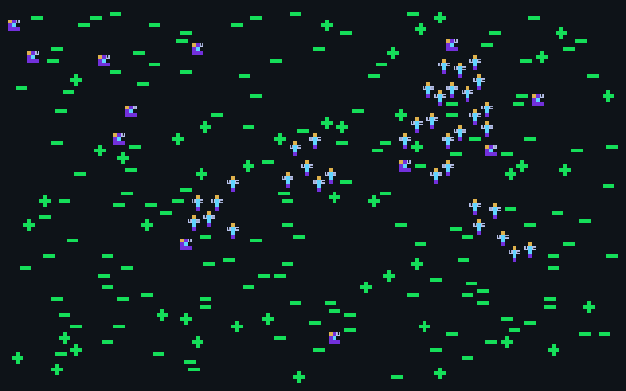
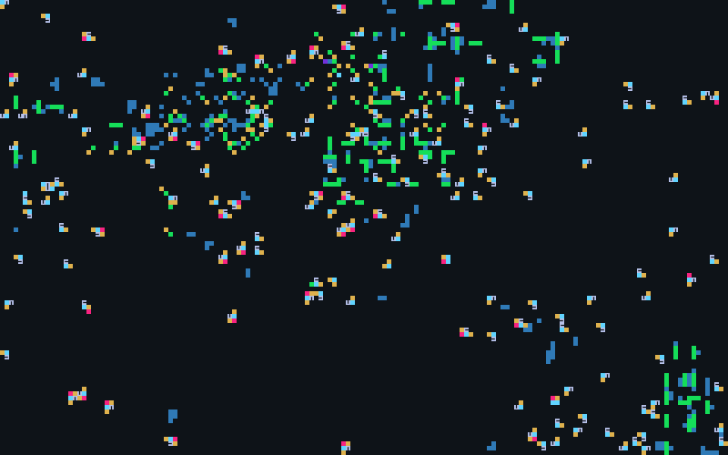

The same run, as the Life Engine drew it
BEFORE · IN THE ENGINE
Tick 0
Tick 10,000
Tick 14,881
36 zebras with no killer cell, 12 rhinos, 140 grass and 45 bush plants.
156 zebras, 26% with a pink killer cell. Bushes and rhinos gone; 113 grass plants left.
No plants make food any more. The last zebra dies of old age.
Notes:
These are real screenshots from the engine, saved automatically during the run. Pink cells are killer cells. In the middle frame you can see the plants are mostly gone and the map is full of zebras carrying killers. By the end only leftover food cells remain, and nothing can produce more, so the zebras cannot reproduce before old age.

Slide 10
New cells (outlined), plus water, a river, trees and fire
AFTER · THE SAME SPECIES, UPGRADED
mouth
eye
mover
mouth
horn
eye
killer
mouth
eye
tree
tree
tree
woody
woody
woody
eye
stripe
mover
armor
mover
armor
mover
killer
mover
tree
tree
tree
woody
woody
stripe
killer
armor
armor
cache
tree
tree
tree
bush (5 cells)
zebra (8 cells)
rhino (8 cells)
leopard (7 cells)
tree (9 cells, new)
Soil water + rain
River (only rhinos wade)
Trees: cover and caches
Fire in dry plants
Grass unchanged
Notes:
Same species, same starting numbers, but now with our new cell types, outlined with a dashed border. Zebras gain two stripe cells for herd camouflage. Rhinos swap one armour cell for a horn. Leopards gain a cache cell to store surplus food. Bushes are now woody, a separate producer that uses less water and makes poorer food. Trees are a new long-lived plant. The environment also changes: soil water refilled by rain, a river that only rhinos can wade across, tree cover, and fire.

Slide 11
Each feature opens a route to collapse and an escape
AFTER · ONE FEATURE PER MEMBER, ALL CONNECTED
Feature | Owner | Route to collapse | Escape that makes it hard
Horn cell (rhino) | Vimbai | Horned rhinos trample nearby plants and food | Immune to killers; gores attackers, so rhinos survive predation
Stripe cell (zebra) | Moreblessing | More surviving zebras put more pressure on grass | Leopard eyes miss striped zebras in a herd, up to 85%
Cache cell (leopard) | Ashley | Banking food delays breeding | Stored food near trees is spent when hunger would kill
Soil water | shared | Grass needs water, so overgrazed dry soil recovers slowly | Rain refills soil; bushes use half the water and expand when grass falls
Every new setting defaults to off, so the “before” runs reproduce the original engine exactly.
Notes:
These are the four member features. They interconnect: stripes keep more zebras alive, which puts more pressure on grass; soil water decides how fast grass recovers; horns protect rhinos but trample food; the cache keeps leopards hunting zebras through lean periods. Each one was designed as a trade-off: it creates a possible path to evolutionary suicide but also a way out, so collapse is possible but never automatic. That matters because if we had hard-coded a collapse, it would not be evidence of anything. No line of code sets a population or a death; every death comes from old age, damage or hunger.

Slide 12
Rule changes that fixed what the old engine could not do
AFTER · SHARED ECOLOGY
Worse bush food
Grazing
Hunger
Browse is worth 0.35 of grass food: a poor fallback.
A mouth next to grass damages it, so overgrazing is possible.
Pay 1 food every 80 ticks; 10 missed payments and you starve.
Meat and jaws
Sprint and kick
Costly armour
Carcasses become meat; leopards eat meat only, so they need prey.
Extra movers add speed only when chasing or fleeing; zebra kicks hit predators.
Armour adds health but costs food, so rhinos breed slowly.
River
Trees
Fire
Wet, fertile banks; only large animals can wade across.
Long-lived cover that hides animals; the only place caches fill.
Spreads through dry plants; wet ground and grazed gaps stop it.
Notes:
These rules were needed to test the hypothesis from our plan at all. Without worse bush food there is nothing to switch to; without grazing damage, mouths cannot deplete grass; without hunger, scarcity is not lethal; without meat-only leopards, predators never depend on prey. We also added a logger, EcoStats, which records the cause of every death so we can tell suicide from predation.

Slide 13
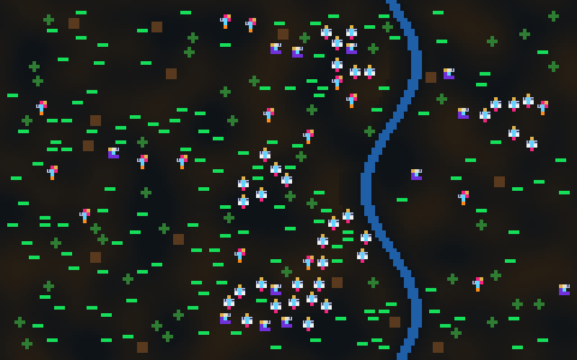
Same animals, a different world around them
AFTER · IN THE ENGINE
Before · tick 0
After · tick 0
After · tick 40,000
Flat dark map. No water or trees, and nothing can starve.
Soil water shading, a river, 14 trees and 16 leopards added.
996 grass plants, 208 zebras; leopards and rhinos already extinct.
Notes:
The organisms themselves are built from the same kinds of cells, which is why they look similar to the original Life Engine. What changed is the world and the rules: the brown shading is soil water, the blue band is the river, the brown squares are trees, and violet cells are browse from bushes. On the right, 40,000 ticks later, grass covers the map and only zebras remain.

Slide 14
Zebras survived only where they evolved a second mouth
AFTER · FIVE 100,000-TICK RUNS
Seed | Leopards: peak, extinct | Rhinos: peak, extinct | Zebras: peak, outcome | Max mouths
1 | 35, tick 4,400 | 80, tick 12,600 | 290, survived (199 at 100k) | 1.99
2 | 26, tick 4,600 | 38, tick 13,900 | 120, extinct at 48,700 | 1.10
3 | 26, tick 12,800 | 67, tick 9,600 | 67, extinct at 94,400 | 1.20
4 | 26, tick 5,900 | 27, tick 5,100 | 136, extinct at 55,900 | 1.00
5 | 26, tick 3,600 | 31, tick 17,300 | 121, extinct at 18,200 | 1.03
Leopards: boom then bust in 5 of 5.
Rhinos: died out in 5 of 5, mostly of old age.
Zebras: survived in 1 of 5 (highlighted).
Notes:
This is the full modified engine, five seeds, 100,000 ticks each. Every leopard population boomed from 16 to 26 to 35 and then died out within 13,000 ticks. Every rhino population died out within 18,000 ticks. Zebras survived only in seed 1, the only seed where the mouth trait spread to nearly two mouths per zebra. In the others, mouths stayed near one and the zebras slowly faded. The next two slides show seed 1 and seed 4 side by side in the engine’s chart style.

Slide 15
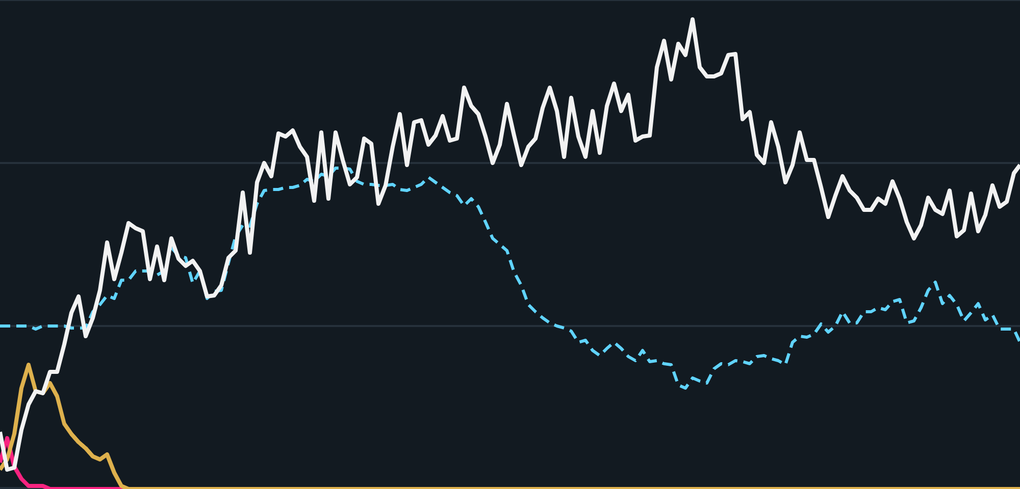
The second mouth spread, and the herd held
AFTER · SEED 1 · ADAPTATION
Zebras
Rhinos
Leopards
Mouths per zebra (right axis)
1.0 → 1.99
300
3
mouths per zebra by tick 33,100
290 peak
200
2
199 zebras still alive at 100,000
4,400
leopards extinct after a peak of 35
100
1
No crash
grass stayed near 1,000 plants
0
0
0
25k
50k
75k
100k ticks
Notes:
This is the success case after our changes. Leopards boomed on the herd and were gone by tick 4,400. Rhinos lasted until 12,600. The zebras then evolved a second mouth: the average went from 1.0 to 1.99, and the herd peaked at 290 and was still 199 at the end. This is the trait our hypothesis said would cause suicide, but it did not: grass did not crash, it stayed around 1,000 plants, because water-limited regrowth and the bush fallback kept the food supply going. Later in the run the mouth average drifted back down as body plans kept changing, but the herd stayed large.

Slide 16

No trait spread, and the herd faded with food all around
AFTER · SEED 4 · FAILURE TO ADAPT
Zebras
Rhinos
Leopards
Mouths per zebra (right axis)
1.00
300
3
mouths per zebra, never changed
55,900
200
2
zebras extinct (dashed line) after a peak of 136
947 plants
100
1
grass and bushes still alive at tick 40,000
Old age
0
0
main cause of zebra deaths, not starvation
0
25k
50k
75k
100k ticks
Notes:
This is the contrast case. Same world, same rules, different seed. Here the second mouth never spread: the dashed blue line is flat at one mouth per zebra. The herd peaked early at 136 and then declined slowly over about 50,000 ticks, mostly dying of old age, while there was still plenty of food: 532 grass and 415 bush plants at tick 40,000. Nothing rose first and then collapsed, so this fails criteria 1 to 3. It is failure to adapt, not evolutionary suicide. Seeds 2, 3 and 5 followed the same pattern, with starvation killing only 4 to 81 zebras per run.

Slide 17
What each species did, before and after
EFFECTS ON BEHAVIOUR
Species | Before (base engine) | After (savanna engine)
Zebras | Evolved killer cells that ate plants as food, boomed, then destroyed every plant | Grazed; in surviving lineages swapped defences for a second mouth: eyes 2.0 → 0.49, stripes 2.0 → 0.02, kick 1 → 0
Rhinos | Died out in every condition; in one harsh seed evolved killers and met all four criteria | Rose to 27–80, then aged out: 16 food per calf was too slow to replace themselves
Leopards | Could eat plant food, so never tied to prey; boom then bust | Meat only: boomed from 16 to 26–35 on the herd, then aged out or were kicked to death
Plants | Only killer cells could remove them; otherwise could clog the map | Grass limited by soil water; bushes expanded where grass fell; fires small and patchy
Notes:
The biggest behaviour change is in the zebras. Before, the route to success was a killer cell that turned plants into meals. After, plants cannot be eaten that way, so success came from grazing more efficiently. Once leopards were gone, eyes, stripes and the kick were dead weight. A smaller body needs less food per calf, and a second mouth gathers food faster, so the streamlined lineage won. That is adaptation to a changed environment, the leopards disappearing, not suicide. Rhinos changed from being an occasional suicide case to a clear failure to adapt. Leopards became truly dependent on prey, which is what made them boom and bust.

Slide 18
What sent lineages down different paths
EVOLUTION OVER TIME
Predators disappeared
Chance in the same world
With leopards gone, zebras shed defences: eyes 2.0 → 0.49, stripes 2.0 → 0.02, kick 1 → 0, mouths → 2.0. In one run the body shrank from 8 to 4.3 cells.
Identical start, different seed: the second mouth spread in seed 1 (1.99) but not in seeds 2–5 (1.00–1.20). One lineage survived; the others faded.
Environment
Rules of the world
Drought pushed mouths up to 2.8; better bush food 2.10; high rain 1.70. Low mutation kept zebras at 1.01.
Before, killing a plant paid a meal, so killer cells spread (0 → 70%). After, that route was closed, so grazing traits spread instead.
Notes:
The brief asks how our species evolve and what produces divergent paths. Four things did. First, predation pressure: once leopards were gone, eyes, stripes and the kick were dead weight, and the lineages that dropped them and gained a second mouth needed less food per calf. Second, chance: the same world with a different seed gave opposite outcomes, depending on whether the mouth mutation appeared and spread early. Third, environment: drier or poorer conditions pushed mouths higher. Fourth, the rules themselves decide which traits pay: killers before, mouths after.

Slide 19
Niches only appeared once the world had structure
ECOLOGICAL NICHE
Species | Before | After | Change the environment…
Zebra | Generalist grazer | Herd grazer on open grass; wet riverbank as refuge | No river or no soil water: 0 of 3 lineages survive
Rhino | Grazer, hunted by leopards | Slow armoured grazer; the only animal that wades the river | Scarce food: survived in 1 of 3 seeds
Leopard | Hunter that could also eat plant food | Meat-only ambush hunter, caching near trees | No trees: cached anywhere, peaked at 110, persisted once
Grass / bush | Same food, same role | Grass: thirsty, fast. Bush: deep roots, takes over dry ground | No soil water: grass spreads unchecked
Notes:
Before our changes the species barely had niches: grass and bush gave identical food, and leopards could eat plants, so nothing was tied to a particular resource or place. After, each species has a clear place. Zebras depend on open grass and the wet riverbank. Rhinos are the only animals that can cross the river. Leopards hunt from cover near trees, the only place caches fill. Changing the environment moves these niches: without the river zebras lose their refuge and die out; with scarce food the slow rhinos do better; without trees the leopards could cache anywhere and boomed to 110.

Slide 20
The environment mattered as much as the traits
AFTER · SWITCHING ONE FEATURE OFF AT A TIME
Condition | Zebra lineages alive at 40k | Reading
Full design | 4 of 5 | Reference
No river | 0 of 3 | The riverbank refuge kept zebras going
No soil water | 0 of 3 | Water limits matter; exact cause not isolated
No stripes / weak camouflage | 1 of 3 / 0 of 3 | Herd camouflage protects zebras
Mouth cap (1 mouth only) | 1 of 3 | The extra mouth is adaptive, not suicidal
No cache | 3 of 3 | Leopards die sooner, so fewer zebras are eaten
Harsh hunger | 0 of 3 | Energy stress kills grazers and predators alike
With 3 seeds, a one-seed difference is noise. We only read 0 of 3 or 3 of 3 as a clear signal.
Notes:
Ablations switch off one feature and keep everything else the same, so we can see what each feature actually does. The clearest results: removing the river or soil water killed every zebra lineage, and removing stripes made zebras die out fastest. The mouth cap is the key test of our hypothesis: if the extra mouth were suicidal, blocking it should have helped. It made things worse, 1 of 3 against 4 of 5, so the trait is adaptive. Surprisingly, removing the leopard cache saved every zebra lineage, because leopards died sooner.

Slide 21
Longer, drier, more leopards, stronger fire: still no suicide
AFTER · 18 FOLLOW-UP RUNS
2.8 mouths
1,300 ticks
160 cells
Drought, 200k ticks
48 leopards
10× fire chance
Food fell, and zebras grew extra mouths in response. Food kept falling after the last zebra died: grass crowding caused the shortage, not grazing.
The herd was eaten in about 1,300 ticks, then the leopards starved. Over-exploitation from starting numbers, not an evolved trait.
Burning rose 2.6×, but no single fire passed 160 cells. Scattered plants on wet soil gave fire no connected fuel.
Notes:
We ran these to answer three open questions: would a longer or drier run eventually produce overgrazing suicide, would more leopards persist, and would stronger fire change who survives. In the long dry run, grass food fell from about 1,550 to 166 cells and zebras evolved up to 2.8 mouths, but food kept falling after the zebras were gone, so the zebras were responding to scarcity, not causing it. That fails criterion 3. With 48 leopards we saw the textbook predator over-exploitation collapse, but it came from the starting density, not a trait, so it is ecological, not evolutionary.

Slide 22
The four questions, answered
ANSWERS TO THE BRIEF
1 · Did extinction occur?
2 · Mis-adaptation or failure?
Yes, in almost every run. Before: rhinos and leopards in every default run, zebras in 2 of 3. After: every leopard and rhino population, zebras in 4 of 5.
Both. Mis-adaptation before: evolved plant-killing zebras (3 of 3) and rhinos (1 seed). Failure to adapt after: all rhinos, and zebras whose mouth trait never spread.
3 · Environment vs seeded species?
4 · What was instrumental?
Environment was as decisive. The same zebras suicided before and adapted after. No river or no water: 0 of 3. Seeding 48 leopards: herd eaten in 1,300 ticks.
Towards: evolved killers, costly rhino armour, single-prey leopards, harsh hunger. Away: river, soil water, stripes, the kick, the second mouth.
Notes:
Question 1: yes. Extinction happened in almost every run, before and after. Question 2: both kinds. Our clearest mis-adaptation was before our changes: zebras evolved a killer cell, the trait spread because every plant it killed was a meal, and it wiped out the producers they lived on. After our changes, collapses were failure to adapt: rhinos breeding too slowly, and zebra lineages where the mouth trait never spread. Leopards were boom and bust, which is ecological, not evolutionary. Question 3: environment mattered as much as the species. The same zebras drove themselves extinct in one world and adapted in another, and removing the river or soil water was as decisive as removing a trait. Question 4: the instrumental traits and features are listed here. The cache delayed leopard collapse but mostly prolonged predation on zebras.

Slide 23
Our features made suicide possible but harder
EVOLUTIONARY DEATH · BEFORE VS AFTER
Before
After
Evolutionary suicide: yes. Zebras in 3 of 3 plant-kill seeds, plus rhinos in one harsh seed. All four criteria met.
Evolutionary suicide: not observed in 97 modified-engine runs.
Instead: failure to adapt (all rhinos; zebras where the mouth never spread) and leopard boom-bust.
Why: a killer cell turned every plant into a meal, so the trait spread while wiping out the producers for good.
Why: water-limited regrowth and the bush fallback kept the extra mouth from destroying its own food.
Other deaths: slow ageing-out, because nothing could starve.
Notes:
This is the main comparison the brief asks for. Before our changes, the engine produced clear evolutionary suicide: a trait that helped each zebra destroyed the food the whole population depended on. After our changes, every route to collapse had an escape, so the same kind of suicide did not happen. Evolutionary death still happened a lot, but for different reasons: species that failed to adapt, and predators that boomed and busted. Our main hypothesis, zebras overgrazing with extra mouths and being forced onto poor bush food, was not observed. The extra mouth spread, but it was adaptive.

Slide 24
No extinction or survival is hard-coded
CODE INSPECTION
Only three ways to die
How you can check
Every organism follows the same rules in Organism.js:
World files only place organisms and set rules; no line sets a population
Every new setting defaults to off, so “before” is the original engine
Same condition, different seeds, different outcomes
Old age: lifetime passes its lifespan
Damage from other cells (bite, gore, kick, fire)
Hunger: too many missed food payments
Rules were tuned in trial runs (e.g. leopard jaws, sprint limits), then frozen; every final run used the same rules.
Notes:
The brief says the code will be inspected to confirm that no extinction or survival is scripted. There are only three ways an organism can die, and they apply to every organism the same way: old age, damage from cells, and hunger. The world generator only places the starting organisms and sets the rule values. The strongest evidence that nothing is scripted is that the same condition with different seeds gives different outcomes. To be transparent, we did adjust general body-part rules during early trial runs, for example how leopard jaws work and when sprinting applies, but those were fixed before the final runs, and every final run used the same rules.

Slide 25
Co-evolution explains why the same trait helped or hurt
WHAT WE LEARNT IN CLASS · LECTURE 9
Lecture idea | What it says | What we saw
Co-evolution | Fitness of one individual depends on others | Zebra eyes, stripes and kick paid off only while leopards lived; after, they were lost
Dynamic fitness landscape | Adapting changes the landscape for everyone | Before: killer zebras reshaped their own landscape into one with no food
Predator–prey (Lotka–Volterra) | Coupled populations should rise and fall together | Only one boom then bust; with 48 leopards, prey eaten then predators starved
Arms race and Red Queen | Species co-adapt; running just to stay put | Stripes vs leopard eyes, kick vs leopards, but leopards died before a race could run
Selection pressure | How strongly the fittest are favoured | Selection is implicit (food → offspring); with no mutation, nothing adapted and all died
Notes:
Lecture 9 says that in co-evolution the fitness landscape is not fixed: it is coupled, and adaptation by one species changes the landscape for others, as in predator-prey interactions. That is exactly what decides evolutionary death in our world. Before, the zebras changed their own landscape by destroying the plants, which is evolutionary suicide. After, the leopards disappearing changed the zebras’ landscape, and the zebras that dropped useless defences won. We expected Lotka-Volterra-style cycles and a Red Queen arms race, but our leopard populations were too small to persist, so we only saw single boom-bust events; that is a limitation. On selection: the Life Engine does not use roulette or tournament selection; organisms that collect food faster simply reproduce more, so selection pressure comes from the environment. The no-mutation baseline shows that without variation there is nothing to select, and every zebra lineage failed to adapt.

Slide 26
Conclusion
Evolutionary suicide occurred in the original engine through an evolved killer cell. After our changes we saw failure to adapt and predator boom-and-bust, but not the overgrazing suicide we predicted.
The extra mouth that spread in our zebras was an adaptation, not a mis-adaptation: water and the river kept it from destroying their food.
Notes:
Our one-line answer: evolutionary suicide depends on the environment as much as on the trait. In the original engine, nothing stopped a successful trait from destroying the food supply, so we saw suicide. In our savanna, every route to collapse had an escape, so populations either adapted, like the streamlined two-mouthed zebras, or failed to adapt, like the slow-breeding rhinos. Limitations to mention if asked: 3 seeds per ablation, settings tuned by trial runs, small leopard numbers, and runs that are not exactly repeatable. Thank you; questions.

